Slide 1
Contemporary impact:
Theme parks, video games, murals and more
Reinventing Culture in East Asia
EASIA 237

Slide 2
Today’s lecture
Overview of additional resources for this unit (2)
Connecting the Qingming scroll to its contemporary legacy (3)
‘Heritage’ review, additional details & perspectives (4)
Ludwig & Wang on theme parks & open air museums (5-8)
Comparison of examples & conclusions (9)
Assignment & Quiz instructions (10-11)

Slide 3
Unit resources
Edmonton mural: Along the River during the Qingming Festival (Kris Friesen 2018)
  97 St., just south of 107 Ave, south wall of Gold Crown jeweler (currently fenced off)
  Links to Chinatown Stories, Artist’s website, Time-lapse video
Minecraft version: 清明上河图 Along the River during the Qingming Festival
  Link to video of Minecraft level
Television drama: Riverside Code at Qingming Festival 清明上河图密码 EP01
  In Mandarin w/ Chinese and English subtitles
  Adapted from novel series by Ye Wenbiao 冶文彪
  Full episode (and series) online—See esp. recreation of scroll in first 6 minutes of EP01.
Theme park videos
  Kaifeng: Millenium Park (Qingming shanghe yuan 清明上河园), Hangzhou: Song City (Songcheng 宋城), Beamish Living Museum (County Durham, England)
  Videos with minimal narration – many more guided tours, etc. on Youtube.

Slide 4
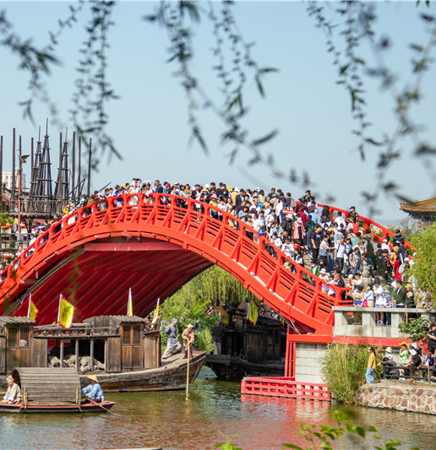
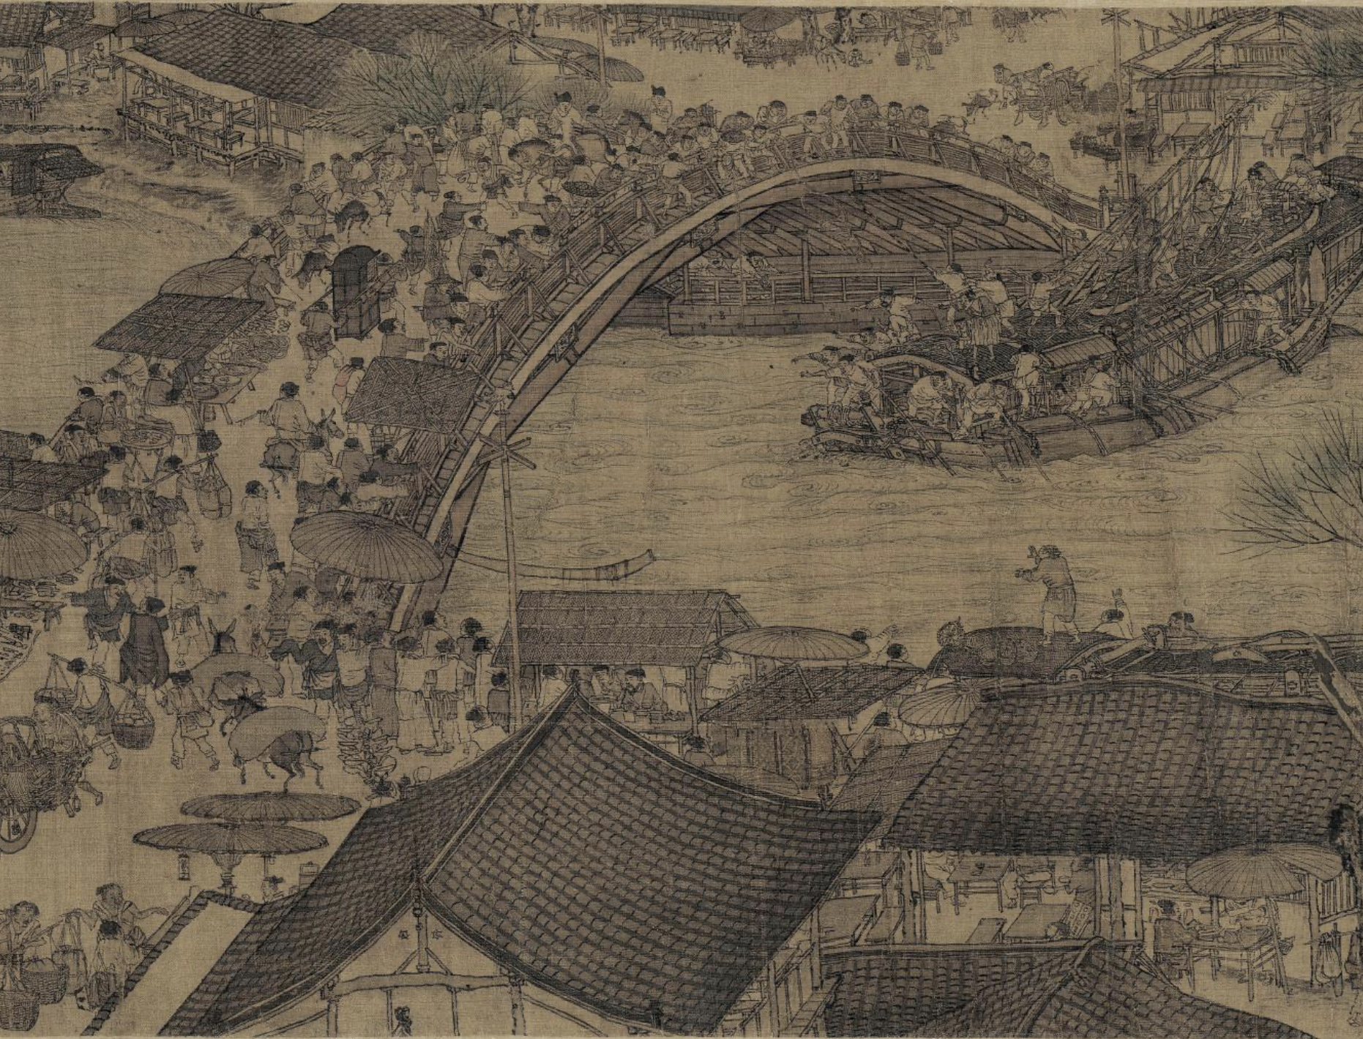
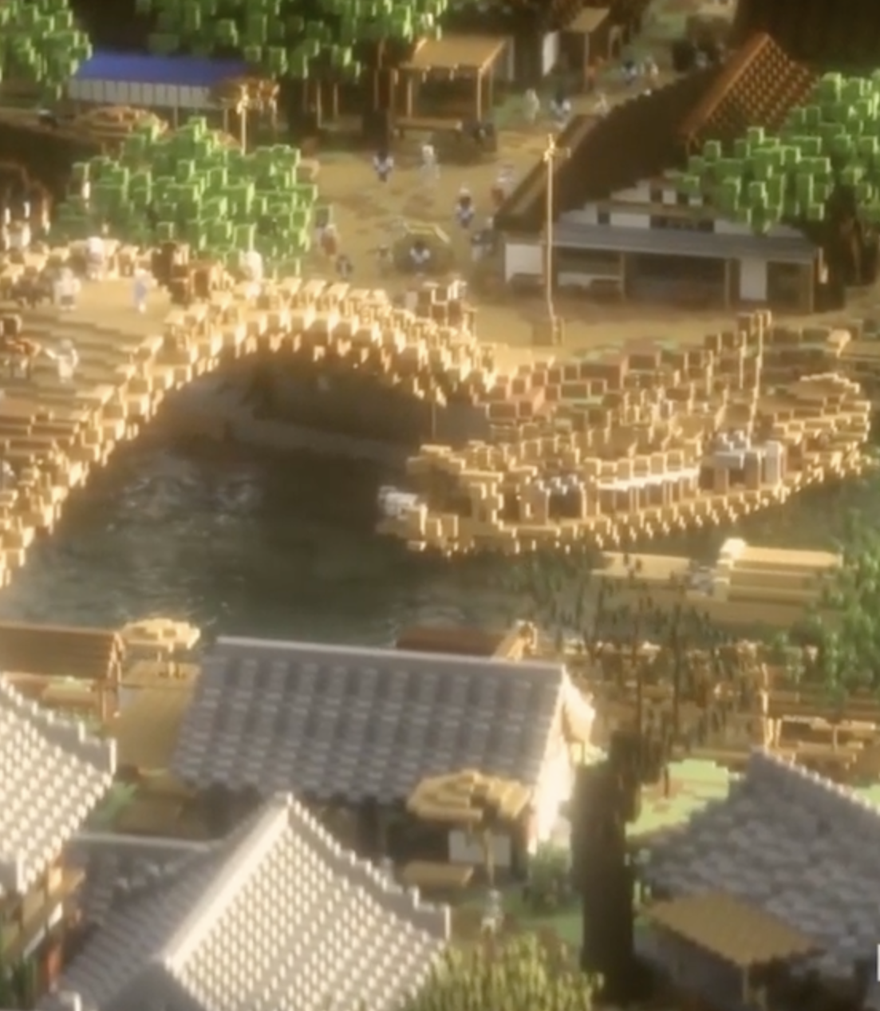
Qingming scroll & its legacy

Slide 5
Qingming scroll & its legacy
All visually inspired by Zhang Zeduan’s Qingming scroll
But why this image? Beyond visual similarity, what is the legacy of this painting?
Scroll as precious artifact / representative example of picture scroll from
Image that captures idealized atmosphere of Song period
Detailed spectrum of premodern practices, aesthetics, etc.
Lively but peaceful urban environment
Note how these do not depend on resolving the questions scholars continue to debate
Other factors?

Slide 6
Heritage
UNESCO and ‘internationally recognized’ heritage
Other agencies, patterns: National, regional governments, etc.
  Preservation, promotion, maintenance, but also...
  Shared sense of inherited culture, identity, but for who? Why? Which version of history?
  Consider in relation to ‘Invented Traditions’: Overlapping goals, outcomes, etc.
‘Heritage’ without ‘official’ recognition?
  “legacy from the past that we live with today and we pass on to future generations”?
  How else can we interpret this? Does it require national/international recognition?
  Who else can recognize / create / participate in heritage?
  Individual, family, community, commercial, etc.
How / when / to whom does ‘authenticity’ matter?

Slide 7
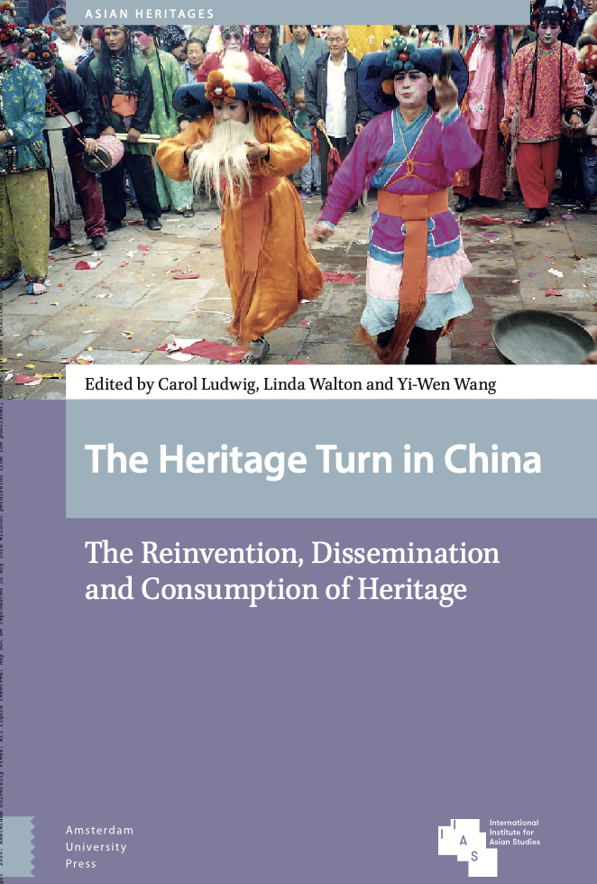

Slide 8
Ludwig & Wang chapter overview
“Contemporary Fabrication of Pasts and the Creation of New Identities?: Open-Air Museums and Historical Theme Parks in the UK and China”
Chapter in edited book: The Heritage Turn in China: The Reinvention, Dissemination and Consumption of Heritage.
Book : Case studies of ‘tangible’ & ‘intangible’ heritage in contemporary China, following “re-awakening” of interest in heritage during the 1980’s.
Architecture, performance, visual art in relation to national & cultural identity, tourism, diplomacy, nostalgia, and more.
Wang and Ludwig: Book editors & ch. authors. Scholars of civic design & urban planning in Xi’an China and Liverpool, UK.
Ch focus: Case studies of open-air museum in England & two historical theme parks in China.
Argument: Both sites challenge dated focus on preservation of original materials & “authenticity,” but also raise questions about how heritage is defined and used.

Slide 9
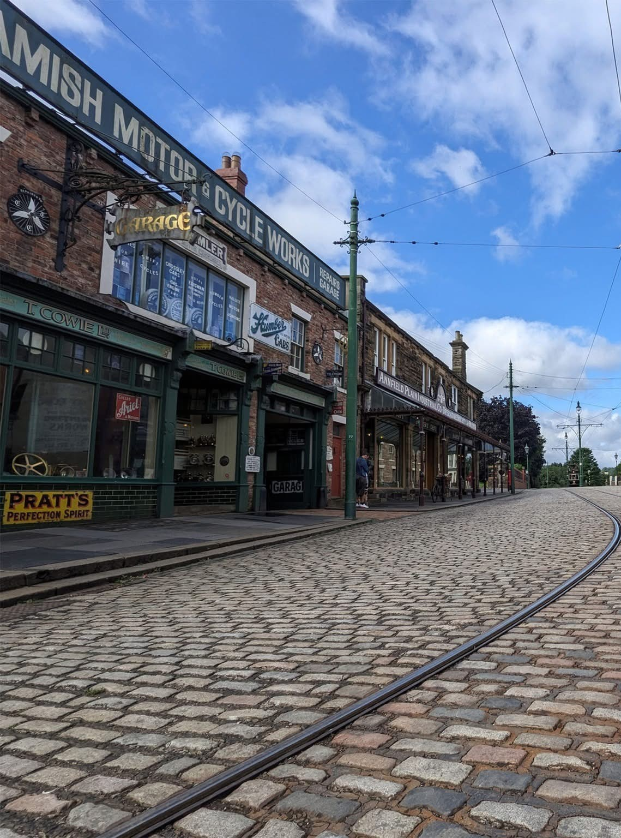
Key points: Beamish Living Museum
Reconstructed coal mining village.
“Time zones”: Early 1800’s & early 1900’s
(later expanded w/ more ‘zones’)
Relocated structures/replicas,
Historical reenactments.
Factual, but incomplete: Performances & exhibits omit negative elements
Education, Tourism, ‘nostalgic pride’

Slide 10
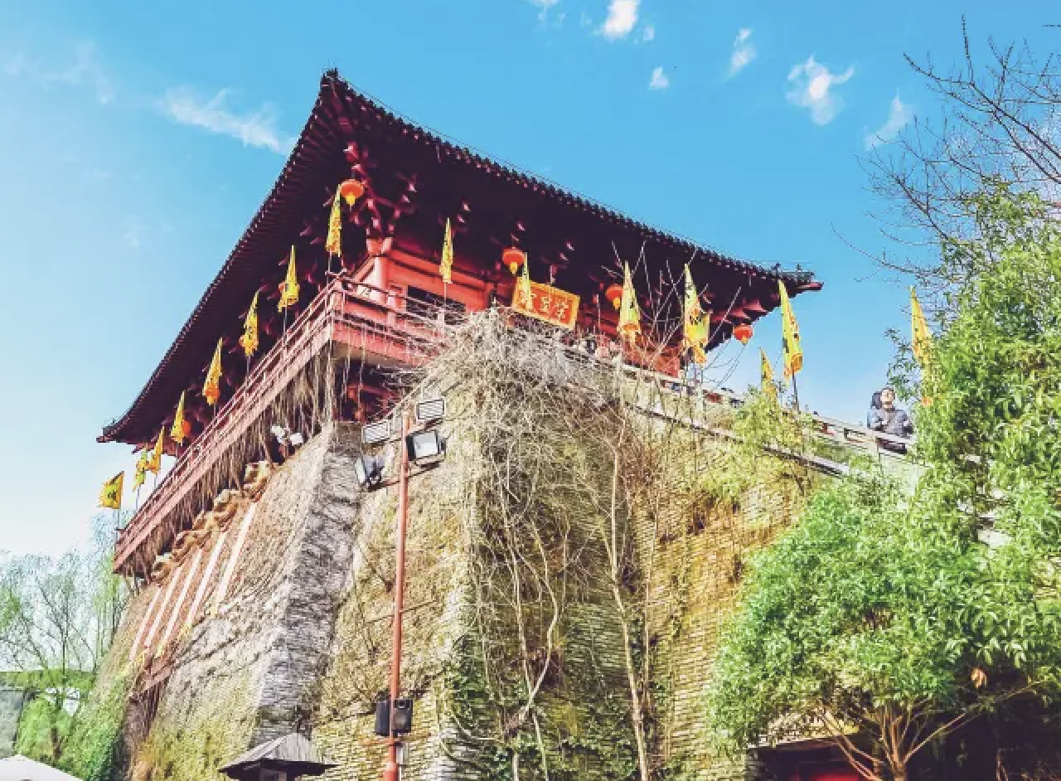
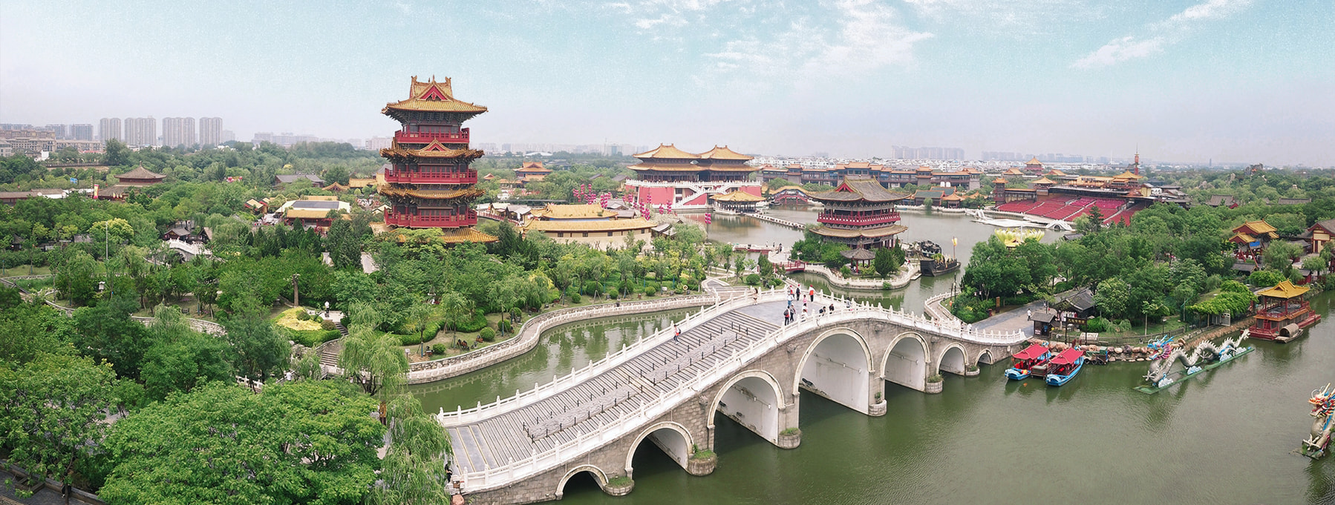
Key points: Song Dynasty Theme Parks
Millenium City Park (Qingming shanghe yuan 清明上河园), Kaifeng. (N. Song capital)
Song City (Song cheng 宋城), Hangzhou (S. Song capital)
Both feature architecture & scenes directly inspired by Qingming painting
But also other performances, structures, activities
Some inspired by traditional crafts & styles, others not...
Rather than ‘authenticity’, focus is on idealized version of Song culture, plus historical fantasy of unspecified period, inspired by contemporary trends and interests.
Resemblance to scenes in the painting is its own ‘authenticity,’
Regardless of how those scenes relate to other parts of history.

Slide 11
Other things to note
What ‘primary sources’ do Ludwig and Wang consult?
  How do they make use of these promotional materials, images, documents, etc.?
When and why do they reference other studies?
  Background / context on inspiration for sites?
  Summarize & analyze scholarly perspectives vs. those of visitors, etc.?
How are studies like this different from those like Hsing-yuan Tsao’s article?
  Asserting & supporting argument vs. raising questions, testing theories, etc.
Why compare a variety of sites, rather than just one? Why these sites?

Slide 12
Comparison
All 3 attractions represent “selective” approach to historical reenactment.
They were built for similar, but not identical goals: Tourism, experience ‘living’ heritage
‘Nostalgia,’ but not always for guest’s own past experiences or memories...
‘National’ pride & shared heritage via reconstructions of specific times & places:
Is this heritage equally meaningful to everyone in the modern nation?
Inclusivity / idealization
Differences: Purported ‘educational’ value? Beamish & claims to authenticity, vs, “experience-centered” Song theme parks. Selective reenactment as preservation vs. fantasy version of idealized past?
Can these contrasts be ascribed to differences in national cultures, governments, etc?
Would comparing different examples allow for different questions, conclusions?

Slide 13
Activity: Comparing case studies
Brainstorm a new research project on contemporary ‘adaptations’ of Qingming scroll.
Choose two or three cases for comparison.
Options:
  One or both theme parks vs. other Qingming ‘versions’ (see ‘Unit resources’)
    E.g Millenium Park vs. Riverside Code tv drama
  One or both theme parks vs. comparable theme park, historic site, etc., in China or elsewhere
    E.g. Song City vs Fort Edmonton Park / Song City vs. West Lake, Hangzhou
  Other Qingming ‘versions’ from Unit Resources vs. similar media inspired by diff. heritage
    E.g. Qingming Minecraft level vs. another video game inspired by an older work of art, etc.
Write a short (1-2 paragraph) explanation of this hypothetical research project.
In addition to introducing examples you would compare, include:
  Preliminary thoughts on how they relate, what we can learn about legacy of Qingming scroll
  Questions further research could answer
  Methods and steps to complete project. Review Ludwig & Wang: What kind of sources do they consult? Who did they talk to? What other scholars’ work do they cite?

Slide 14
Unit quiz & Module Quiz
First, take the Unit Quiz:
  5 questions, 10 minutes
  Focus on this lecture, Ludwig & Wang article, ‘heritage’-related concepts.
  Review both Beamish and Song theme park sections, but latter covered in more detail.
Review module materials, then, take Module Quiz
  15 questions, 30 minutes
  Questions from all 3 units of Module
  Some based on previous Unit Quizzes, others are new
  Will include other question formats. (Matching, ordering, etc.)
  Read question instructions carefully.

Slide 15
Additional reading
Ong, Chin-Ee and Ge Jin. “Simulacra and Simulation: Double Simulation at a North Song Dynasty Theme Park” Tourism Geographies 19.2 (2017): 227-243.
Ludwig, Carol and Linda Walton. “Introduction: (Un)Authorised Heritage Discourse and Practice in China,” in The Heritage Turn in China: The Reinvention, Dissemination and Consumption of Heritage, ed. Carol Ludwig, Linda Walton, and Yi-Wen Wang. Amsterdam University Press, 2020.
Zhu, Yujie. “Cultural Effects of Authenticity: Contested Heritage Practices in China”, International Journal of Heritage Studies 21.6 (2015): 594-608.

